Slide 1
Module-2
SMART OBJECTS

Slide 2
SENSORS
Sensor measures some physical quantity and converts that measurement reading into a digital representation. That digital representation is typically passed to another device for transformation into useful data that can be consumed by intelligent devices or humans.
Naturally, a parallel can be drawn with humans and the use of their five senses to learn about their surroundings. Human senses do not operate independently in silos. Instead, they complement each other and compute together, empowering the human brain to make intelligent decisions.
The brain is the ultimate decision maker, and it often uses several sources of sensory input to validate an event and compensate for “incomplete” information.
Sensors can be readily embedded in any physical objects that are easily connected to the Internet by wired or wireless networks. Because these connected host physical objects with multidimensional sensing capabilities communicate with each other and external systems, they can interpret their environment and make intelligent decisions.
Connecting sensing devices in this way has ushered in the world of IoT and a whole new paradigm of business intelligence.

Slide 3
There are a number of ways to group and cluster sensors into different categories, including the following:
Active or passive: Sensors can be categorized based on whether they produce an energy output and typically require an external power supply (active) or whether they simply receive energy and typically require no external power supply (passive).
Invasive or non-invasive: Sensors can be categorized based on whether a sensor is part of the environment it is measuring (invasive) or external to it (non-invasive).
Contact or no-contact: Sensors can be categorized based on whether they require physical contact with what they are measuring (contact) or not (no-contact).
Absolute or relative: Sensors can be categorized based on whether they measure on an absolute scale (absolute) or based on a difference with a fixed or variable reference value (relative).
Area of application: Sensors can be categorized based on the specific industry or vertical where they are being used.
How sensors measure: Sensors can be categorized based on the physical mechanism used to measure sensory input (for example, thermoelectric, electrochemical, piezoresistive, optic, electric, fluid mechanic, photoelastic).
What sensors measure: Sensors can be categorized based on their applications or what physical variables they measure.

Slide 4
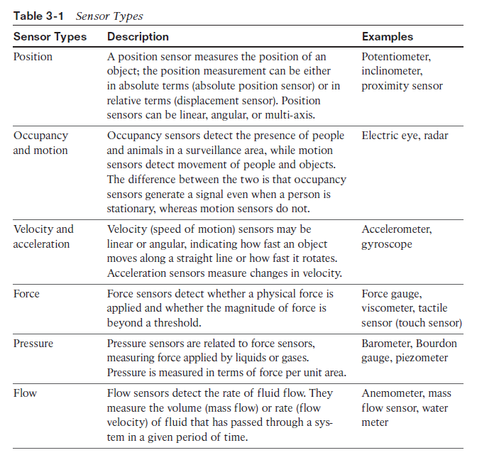

Slide 5
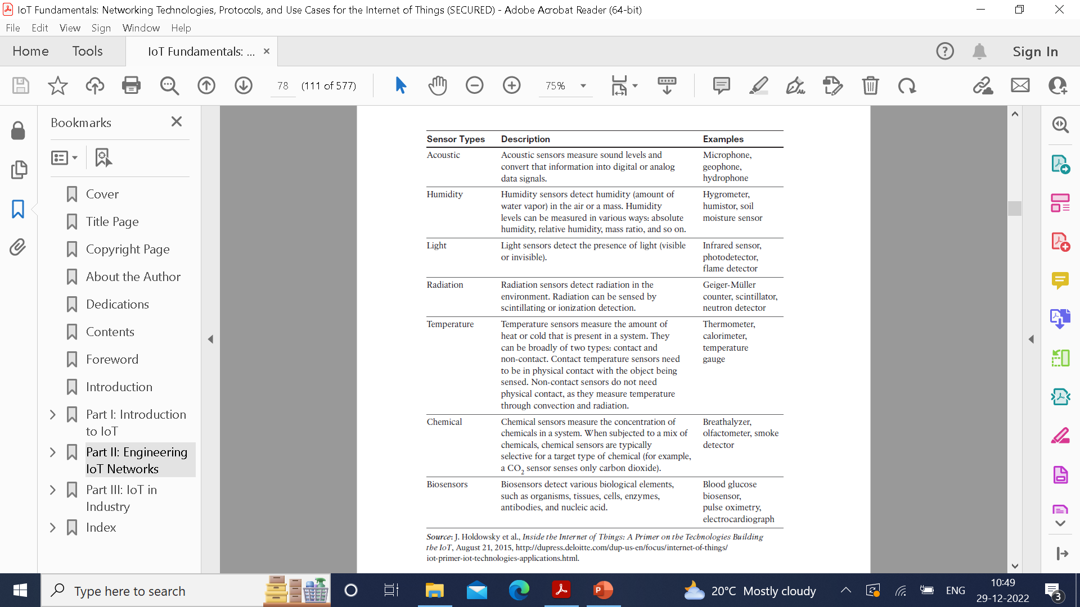

Slide 6
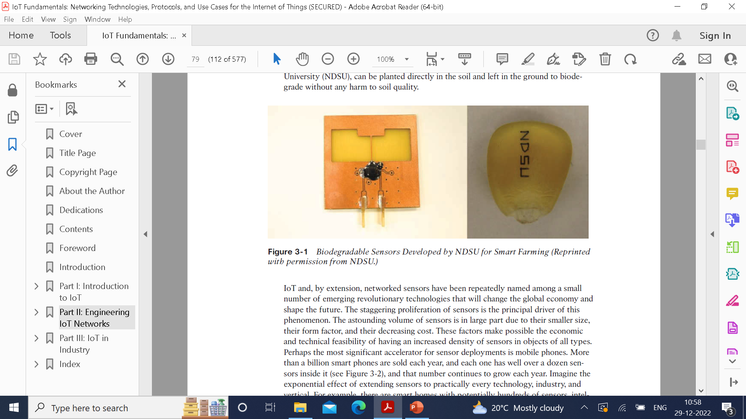
A fascinating use case to highlight the power of sensors and IoT is in the area of precision agriculture (sometimes referred to as smart farming), which uses a variety of technical advances to improve the efficiency, sustainability, and profitability of traditional farming practices.
This includes the use of GPS and satellite aerial imagery for determining field viability; robots for high-precision planting, harvesting, irrigation, and so on; and real-time analytics and artificial intelligence to predict optimal crop yield, weather impacts, and soil quality.
These include real-time measurement of soil quality, pH levels, salinity, toxicity levels, moisture levels for irrigation planning, nutrient levels for fertilization planning, and so on. All this detailed sensor data can be analyzed to provide highly valuable and actionable insight to boost productivity and crop yield.

Slide 7
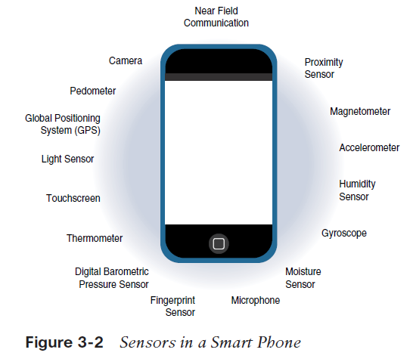
The astounding volume of sensors is in large part due to their smaller size, their form factor, and their decreasing cost. These factors make possible the economic and technical feasibility of having an increased density of sensors in objects of all types.
Perhaps the most significant accelerator for sensor deployments is mobile phones. More than a billion smart phones are sold each year, and each one has well over a dozen sensors inside it (see Figure 3-2), and that number continues to grow each year.
Imagine the exponential effect of extending sensors to practically every technology, industry, and vertical. For example, there are smart homes with potentially hundreds of sensors, intelligent vehicles with 100+ sensors each, connected cities with thousands upon thousands of connected sensors, and the list goes on and on.

Slide 8
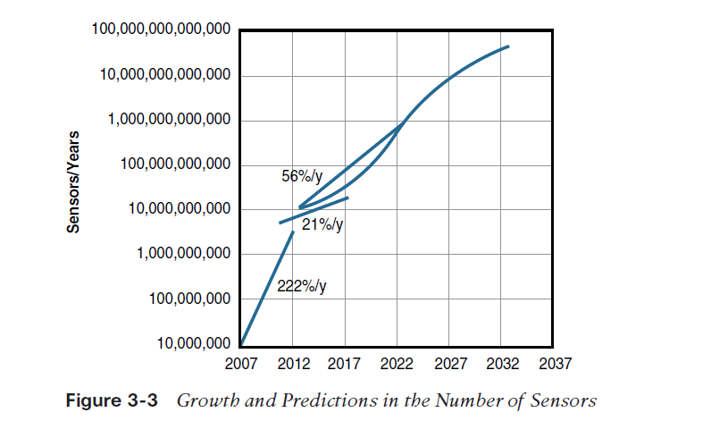

Slide 9
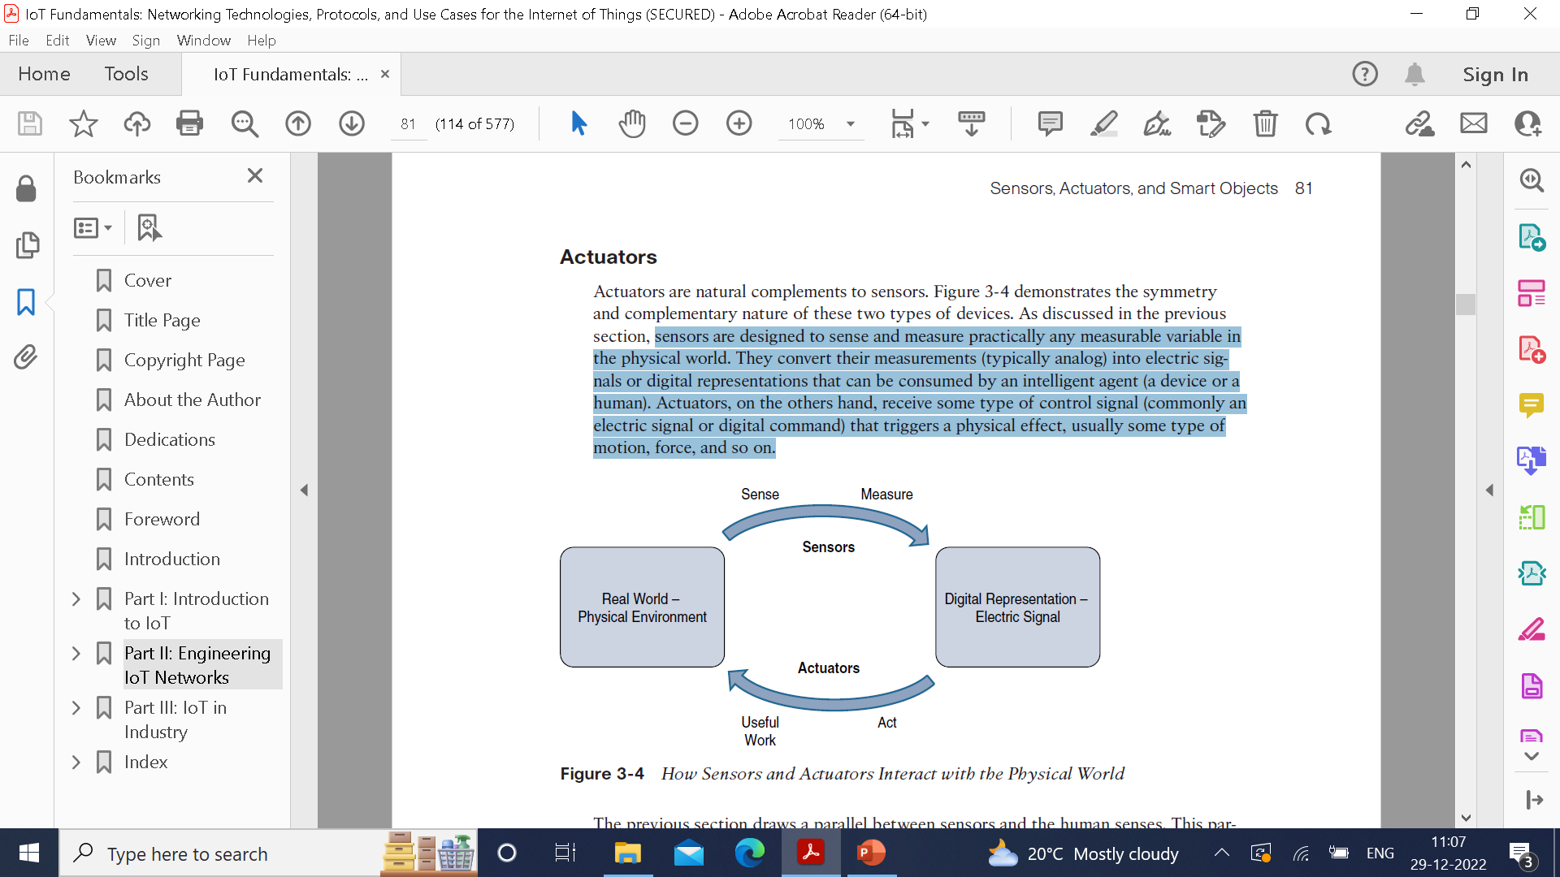
Actuators
Actuators are natural complements to sensors.
Sensors are designed to sense and measure practically any measurable variable in the physical world. They convert their measurements (typically analog) into electric signals or digital representations that can be consumed by an intelligent agent (a device or a human). Actuators, on the others hand, receive some type of control signal (commonly an electric signal or digital command) that triggers a physical effect, usually some type of motion, force, and so on.

Slide 10
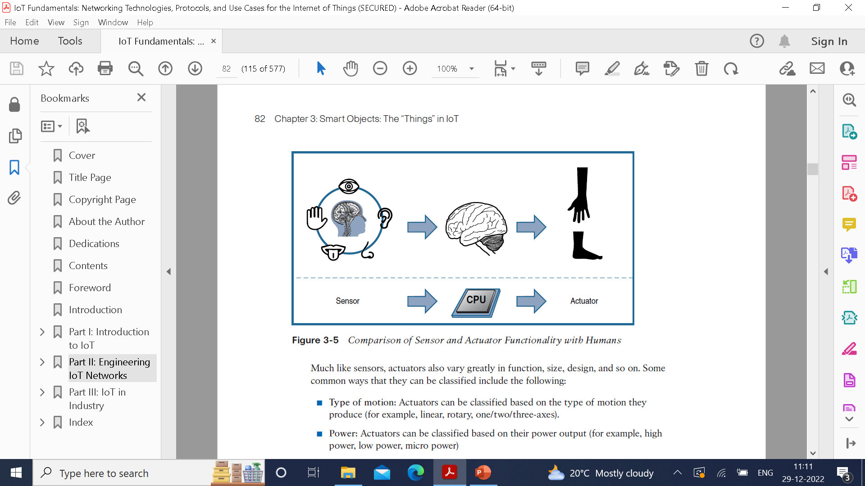
Humans use their five senses to sense and measure their environment. The sensory organs convert this sensory information into electrical impulses that the nervous system sends to the brain for processing.
Likewise, IoT sensors are devices that sense and measure the physical world and (typically) signal their measurements as electric signals sent to some type of microprocessor or microcontroller for additional processing.
The human brain signals motor function and movement, and the nervous system carries that information to the appropriate part of the muscular system. Correspondingly, a processor can send an electric signal to an actuator that translates the signal into some type of movement (linear, rotational, and so on) or useful work that changes or has a measurable impact on the physical world.
This interaction between sensors, actuators, and processors and the similar functionality in biological systems is the basis for various technical fields, including robotics and biometrics.

Slide 11
Some common ways that they can be classified include the following:
Type of motion: Actuators can be classified based on the type of motion they produce (for example, linear, rotary, one/two/three-axes).
Power: Actuators can be classified based on their power output (for example, high power, low power, micro power)
Binary or continuous: Actuators can be classified based on the number of
stable-state outputs.
Area of application: Actuators can be classified based on the specific industry or
vertical where they are used.
Type of energy: Actuators can be classified based on their energy type.

Slide 12
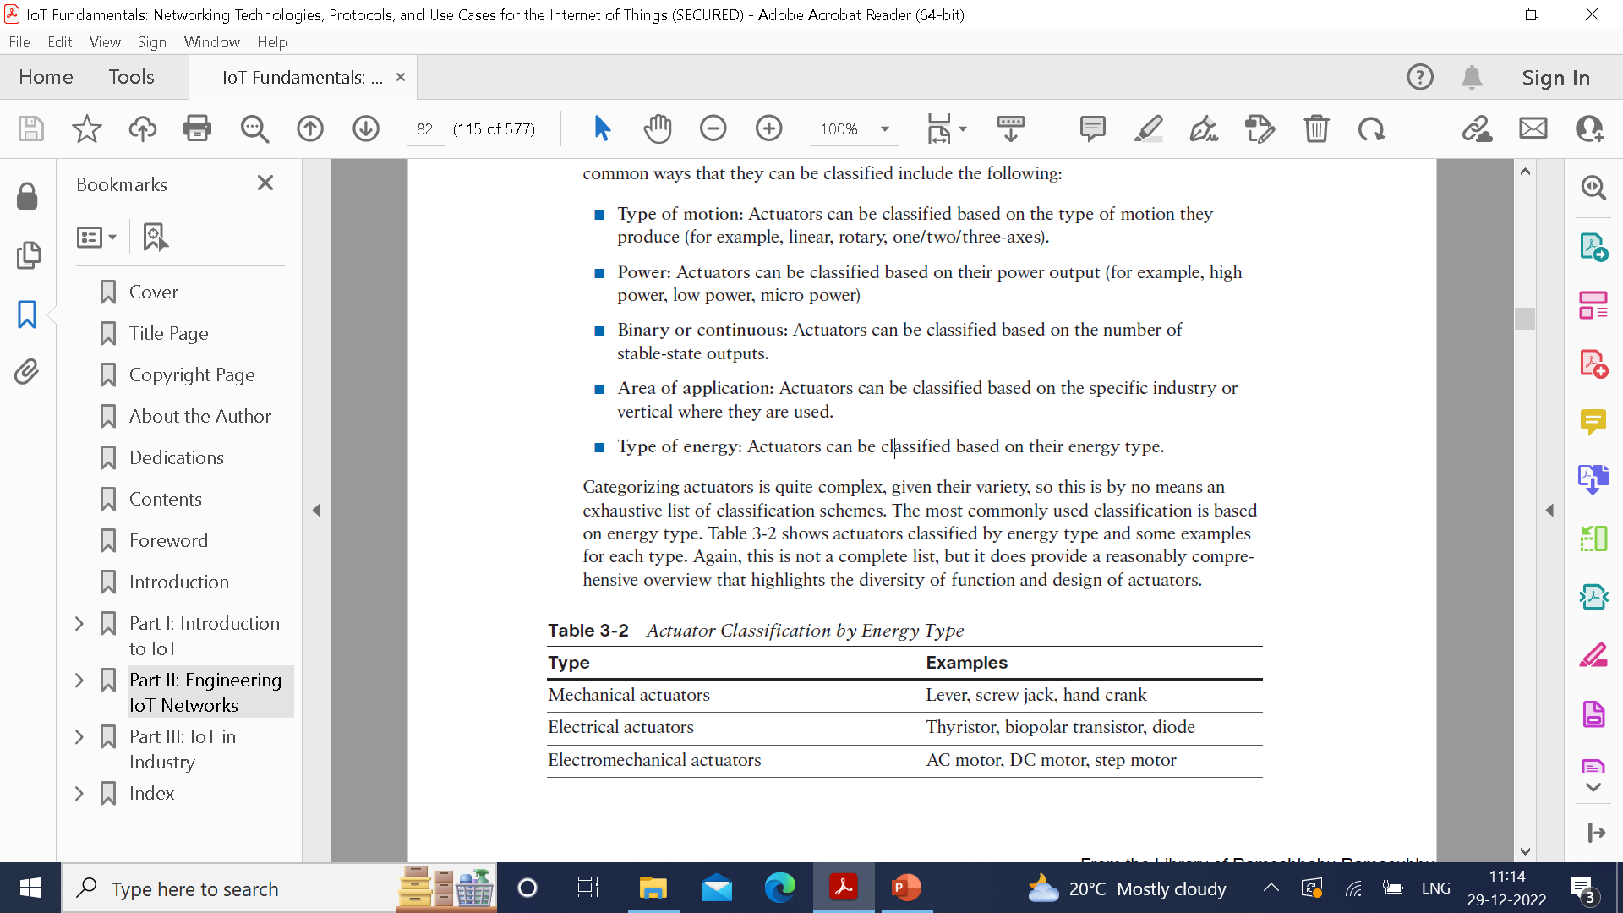
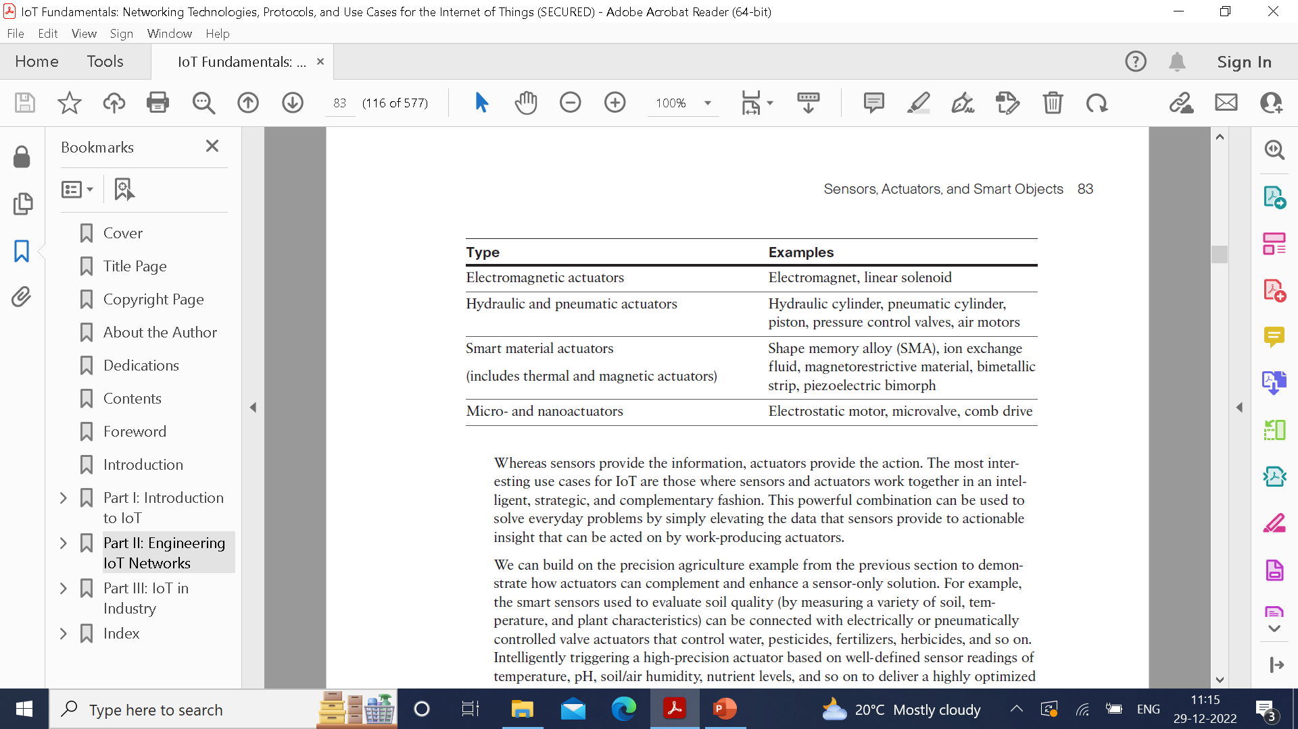

Slide 13

Micro-Electro-Mechanical Systems(MEMS)
MEMS referred to as micro-machines, can integrate and combine electric and mechanical elements, such as sensors and actuators.
Allows mass productivity.
Tiny size, low cost, and attractive for a huge number of IoT applications.
E.g inkjet printers use micro pump MEMS, smart phones uses accelerometer and gyroscope.

Slide 14
Smart Object
The building blocks of IoT.
They transform everyday objects into a network of intelligent objects that are able to learn from and interact with their environment.
It can’t be stressed enough that the real power of smart objects in IoT comes from being networked together rather than being isolated as standalone objects. This ability to communicate over a network has a multiplicative effect and allows for very sophisticated correlation and interaction between disparate smart objects. For instance, recall the smart farming sensors are described.
If a sensor is a standalone device that simply measures the humidity of the soil, it is interesting and useful, but it isn’t revolutionary. If that same sensor is connected as part of an intelligent network that is able to coordinate intelligently with actuators to trigger irrigation systems as needed based on those sensor readings, we have something far more powerful.
Extending that even further, imagine that the coordinated sensor/ actuator set is intelligently interconnected with other sensor/actuator sets to further coordinate fertilization, pest control, and so on—and even communicate with an intelligent backend to calculate crop yield potential

Slide 15
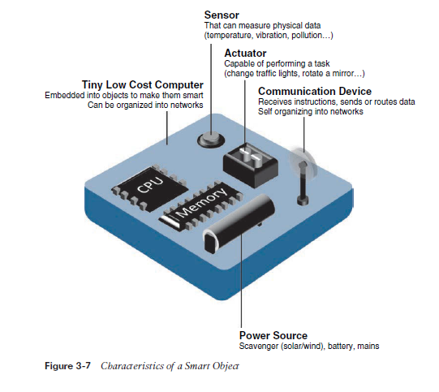
Four characteristics of a smart object:
Processing Unit
Sensor and/or Actuators
Communication Device
Power Source

Slide 16
Trends in Smart Objects
Size in decreasing
Power consumption is decreasing
Processing power is increasing
Communication capabilities are improving
Communication is being increasingly standarized

Slide 17
Sensor Networks
A sensor/actuator network(SANET) is a network of sensors that sense and measure their environment and/or actuators that act on their environment.
The sensors and/or actuator in a SANET are capable of communicating and cooperating in a productive manner.
Effective and well-coordinated communication and cooperation is a prominent challenge, primarily because the sensors and actuators in SANETs are diverse, heterogenous, and resource-constrained.
Highly coordinated sensing and actuation capabilities. Smart homes are a type of SANET that display this coordination between distributed sensors and actuators.
E.g. smart homes can have temperature sensors that are networked with heating, ventilation and air-conditioning(HVAC) actuators.

Slide 18
Advantages of a wireless-based
Greater deployment flexibility
Simpler scaling to a large number of nodes
Lower implementations costs
Easier long-term maintenance
Effortless introduction of new sensor/actuator nodes
Better equipped to handle dynamic/rapid topology changes

Slide 19
Disadvantages:
Less secure
Lower transmission speeds
Greater level of impact/influence by environment

Slide 20
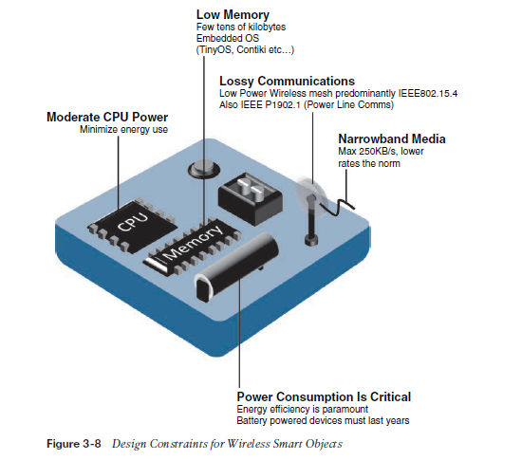
Wireless Sensor Networks
WSNs are made up of wirelessly connected smart objects, referred to as motes.
The following are the limitations of WSNs:
Limited processing power
Limited memory
Lossy communication
Limited transmission speeds
Limited Power

Slide 21
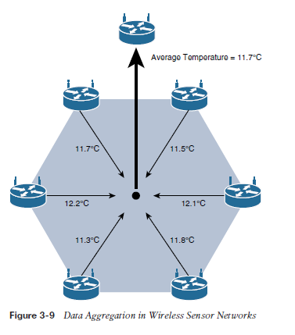
Large number of sensors permit the introduction of hierarchies of smart objects.
It provides the ability to aggregate similar sensor readings from sensor nodes that are in close proximity to each other.
Data aggregation techniques are helpful in reducing the amount of overall traffic in WSNs with very large number of deployed smart objects.
Wirelessly connected object generally have one of the following two communication pattern:
Event-driven
periodic

Slide 22
Communication Protocols for wireless Sensor Network
when selecting a communication protocol, you must carefully take into account the requirements of
the specific application and consider any trade-offs the communication protocol offers between power consumption, maximum transmission speed, range, tolerance for packet loss, topology optimization, security, and so on.
The fact that WSNs are often deployed outdoors in harsh and unpredictable environments adds yet another variable to consider because obviously not all communication protocols are designed to be equally rugged.
In addition to the aforementioned technical capabilities, they must also enable, as needed, the overlay of autonomous techniques.
Wireless sensor networks interact with their environment. Sensors often produce large amounts of sensing and measurement data that needs to be processed.
This data can be processed locally by the nodes of a WSN or across zero or more hierarchical levels in IoT networks.

Slide 23
Communication protocols need to facilitate routing and message handling for this data flow between sensor nodes as well as from sensor nodes to optional gateways, edge compute, or centralized cloud compute.
IoT communication protocols for WSNs thus straddle the entire protocol stack.

